Slide 1
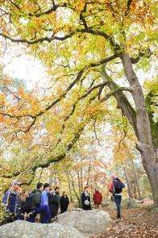
Mastère Spécialisé® Expert en Environnement et Développement Durable Pathway « International Environmental Management» EnvIM
APPLICATION 2025-2026 ISIGE, the MINES Paris - PSL center dedicated to the Environment and Sustainable Development
PERSONNAL INFORMATION
You are* :
Years of professional experience :
Photo
recent graduate /experienced professional
Mrs or Mr
Cell phone
First Name
E-mail
Last Name
Street Address
Date of birth
Zip Code
Place of birth
City / State
Nationality (ies)
Province/Country
Marital status
If you currently reside abroad, please let us know where :
And your expected return date in France :
* Please fully complete this document and highlight the right mentions

Slide 2
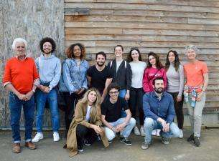
EDUCATION
Degrees | University, majors | Academic results | Years
PhD
Master
Bachelor
High-School Diploma
LANGUAGE SKILLS *
Languages | Level of proficiency
English
French
Native
Written : Spoken :
Written : Spoken :
Written : Spoken :
Written : Spoken :
Fluent Good Basics
Fluent Good Basics
TOEIC SCORE :
In progress
Native
Fluent Good Basics
Fluent Good Basics
Other :
Other :
Native
Fluent Good Basics
Fluent Good Basics
Native
Fluent Good Basics
Fluent Good Basics
* Please fully complete this document and highlight or let the right mentions

Slide 3
PROFESSIONAL EXPERIENCE
Date, duration | Position | Employer / Company | Work location (city / country)
Current situation or work status : Recently graduate, working, unemployed :….
MOTIVATIONS Please answer the following questions on a separate document (4 to 5 pages). 1. What are your main motivations for this post Master application ? 2. How could you, with your own background and field of expertise, contribute to an interdisciplinary problem - analysis and problem-solving ? 3. What are your professional goals and career project? How could this program help you to fulfill your goals ?

Slide 4
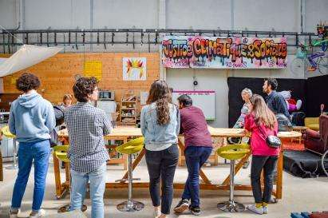
Other applications
Are your applying for other programs ? If so, which ones and why ?
Yes
No
Information source How have you discovered this postmaster’s programme ? Tick the box (es) , many answers are possible.
A teacher in my school / university A former ISIGE alumni, name : ….. A colleague of mine Campus France services Browsing the ISIGE website Browsing post-masters in Environment Browsing something else Others : ……..
I certify that all information I have provided in this form are true and complete.
Date :
Signature :

Slide 5
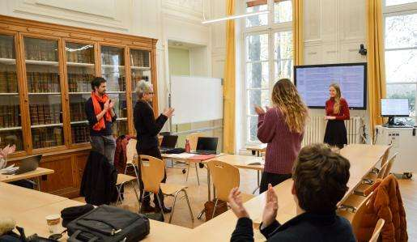
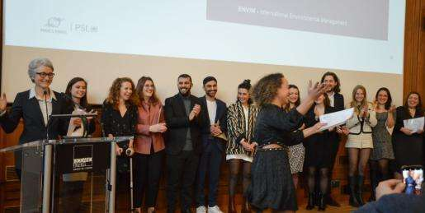
REQUESTED DOCUMENTS (1/2) Application dossier for EnvIM : Please add your name on each document for better traceability, pdf format is preferred, all digital documents sent via email, Example : 1_ROQUET_Application form 2025-2026 1_your name_APPLICATION FORM 2024-2025 completed and signed, with a passport size photo included first page on the form, if you can't include the photo, join it to the file. 2_your name_ANSWERS TO THE MOTIVATION QUESTIONS, (5 pages maximum) 3_ your name_RESUME 2 pages max. 4_your name_ACADEMIC TRANSCRIPTS : certified copies of your grade transcripts (Master / Bachelor or equivalent) 5_your name_DIPLOMA a Master degree certificate, (or equivalent degree), or a “provisional degree certificate (in english)” a copy of a Bachelor Degree certificate (or equivalent degree) 6_your name_TOEFL OR TOEIC RESULTS English language ability : a copy of TOEIC/TOEFL score or any other equivalent test – except native English speaker - or if you have a degree in an University where English is the language of instruction 7_NATIONAL IDENTITY CARD or passport

Slide 6
REQUESTED DOCUMENTS (2/2) Recommendation letters in English or French : 3 Recommendation letters using the downloadable forms on : http://www.isige.mines-paristech.fr/formations/candidater/ by three qualified persons sent by email by your referee to secretariat@isige.mines-paristech.fr Note : YOUR APPLICATION WILL BE CONSIDERED COMPLETE WHEN WE RECEIVE THE APPLICATION DOSSIER AND 3 RECOMMENDATION FORMS. WE WILL CONFIRM RECEPTION OF YOUR APPLICATION BY EMAIL. If you do not receive an e-mail from us within 3 days, please contact us. Email your application dossier (or using WeTransfer) to : secretariat@isige.mines-paristech.fr

Slide 8
Suivez-nous sur LinkedIn ISIGE - Mines Paris-PSL
Contact : secretariat@isige.mines-paristech.fr
ISIGE – Mines Paris-PSL
35, rue Saint-Honoré
77300 FONTAINEBLEAU

